Slide 1
NIVAbasen
O_NUMBER PROJECT_ID
O_NUMBER
BIOTA_SAMPLES_SPECIMENS SPECIMEN_ID
BIOTA_SAMPLES_SPECIMENS_ID
SAMPLE_ID
PROJECTS PROJECT_ID
PROJECT_NAME PROJECT_DESCRIPTION
1-2 lines per station
One line per fish specimen or mussel batch
BIOTA_TISSUE_TYPES TISSUE_ID
TISSUE_NAME
PROJECTS_STATIONS STATION_ID
STATION_CODE STATION_NAME PROJECT_ID PROJECTS_STATION_ID
One line per tissue sample (may be a pooled sample)
SPECIES SPECIES_ID
LATIN_NAME
BIOTA_SINGLE_SPECIMENS STATION_ID
SPECIMEN_ID
SPECIMEN_NO (1, 2, …)
DATE_CAUGHT
TAXONOMY_CODE_ID
BIOTA_SAMPLES SAMPLE_ID
SPECIES_ID
TISSUE_ID
STATION_ID
TAXONOMY_CODE_ID
SAMPLE_DATE
SAMPLE_NO
REPNO
Note: date can be two places
STATIONS STATION_ID
GEOM_REF_ID
NIVA_GEOMETRY. SAMPLE_POINTS SAMPLE_POINT_ID
LONGITUDE
LATITUDE
One line per measurement
One line per method
BIOTA_CHEMISTRY_VALUES SAMPLE_ID
METHOD_ID
VALUE_ID
VALUE
FLAG1
DETECTION_LIMIT UNCERTAINTY QUANTIFICATION_LIMIT
METHOD_DEFINITIONS METHOD_ID
NAME (substance)
UNIT
LABORATORY
METHOD_REF
MATRIX
Excel: metadata (Bjørnar) + biological effects (Anders)
TAXONOMY_CODES TAXONOMY_CODE_ID
CODE (ex. «GADU MOR»)
NIVA_TAXON_ID
BIOTA_SPEC_ATTR VALUE_ID
SPECIMEN_ID
ATTRIBUTE_ID
VALUE_T (text)
VALUE_N (number)
BIOTA_SPEC_ATTR_DEF ATTRIBUTE_ID
NAME (Lengde, Vekt, Kjønn…)
UNIT
DESCR
VALUE_TYPE (T or N)
TAXONOMY NIVA_TAXON_ID
LATIN_NAME

Slide 2
CEMP Access database
dbo_fish_mas myear
seqno
rlabo
jmpst
speci
sdate
dbo_fish_spe myear
seqno
rlabo
subno
lnmea
wtmea
sexco
gonwt
imposex_sh ++
dbo_fish_tis myear
seqno
rlabo
subno tissu
tiswtx
drywtx
dbo_fish_con myear
seqno
rlabo
subno tissu
param
valsnf
inorb
vflag
qflag
unit
dbo_fish_becon myear
seqno
rlabo
subno tissu
param
tiswtx
drywtx
dbo_locality jmpst
stnam
[coordinates]
One record per station, year and lab
One record per fish specimen or mussel batch
One record per tissue sample
One record per measurement (chemical data)
One record per measurement (biol. effects)
A list of all fields in all tables can be found in "doc_rptObjects.txt" (from Data/CEMP/2014_COCO/downloaded 2014-11-27) No tables seems to give a good link to NIVAbasen (searched for SPECIMEN_ID, SAMPLE_ID etc.)

Slide 3
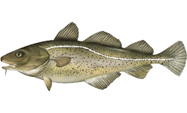
Representing pooled samples, Nivabase
BIOTA_CHEMISTRY_VALUES
Sample_id | PARAM | VALUE
501 | HG | 0.15
501 | DRYWT% | 18
501 | … | …
505 | CB118 | 10.5
505 | DRYWT% | 44
505 | … | …
1
Muscle 1
2
Muscle 2
3
Muscle 3
Liver 1
4
Liver 2
Fish length
BIOTA_SPEC_ATTR
Specimen_ID | Value_n
101 | 50 cm
102 | 45 cm
103 | 75 cm
104 | 35 cm
BIOTA_SINGLE_SPECIMENS
Specimen_no | Specimen_ID
1 | 101
2 | 102
3 | 103
4 | 104
BIOTA_SAMPLES_SPECIMENS
Specimen_ID | Sample_ID
101 | 501
102 | 502
103 | 503
103 | 504
102 | 505
104 | 505
BIOTA_SAMPLES
Sample_id | Tissue | Sample_no
501 | MU | 1
502 | MU | 2
503 | MU | 3
504 | LI | 1
505 | LI | 2

Slide 4
Representing pooled samples, ICES
1
Muscle 1
2
Muscle 2
3
Muscle 3
TABLE 10
MATRX | SUBNO | PARAM | VALUE
MU | 1 | HG | 0.15
MU | 1 | DRYWT% | 18
MU | 1 | … | …
LI | 5 | CB118 | 10.5
LI | 5 | FATWT% | 44
LI | 5 | … | …
WO | 1 | LNMEA | 50
WO | 2 | LNMEA | 45
WO | 3 | LNMEA | 75
WO | 4 | LNMEA | 35
Liver 1
4
Liver 2
TABLE 04
SUBNO | BULKID
1
2 | 5
3
4 | 5
5
Fish length

Slide 5
Dataflyt og prosedyrer
Last year’s table
OSPAR
The big Excel table
Raw data Basis WW, DW, FB
2016
NIVAbasen
data_all
1981-2015
data_all_median
df_background
Accessbase
2015-2016
data_all2
1981-2014
data_all_median_for_regression
trend_tables
Summary trend table
Fisk lengde/vekt 2015-2016
1981-2015
data_all_2015sp
Length-adjusted data Basis WWa, DWa, FBa
Summary level table
Fisk biol. effekter 2016
Time series graphs
Snegl imposex
2016
data_all was used for producing unadjusted concentrations
data_all_2015sp was used for producing length-adjusted concentrations
The reason for the split was that for 2015, length-adjusted concentrations could not be produced from the Access data due to some mess in the index numbers
1981-2015

Slide 6
Dataflyt og prosedyrer Med scriptnr.
Last year’s table
OSPAR
The big Excel table
12_Add_Accessdata_to_NIVAdata.R
09_extract_NIVAdatabase.R
Raw data Basis WW, DW, FB
13b8_Write_Excel_file.R
2016
13b5_Calc_background.R
NIVAbasen
data_all
1981-2015
data_all_median
df_background
Accessbase
2015-2016
data_all2
44_make_overview_trend_table.R
1981-2014
03_collect_individual_fish_data.R
data_all_median_for_regression
Summary trend table
Fisk lengde/vekt 2015-2016
data_all_2015sp
13b5_Calc_background.R
trend_tables
1981-2015
Length-adjusted data Basis WWa, DWa, FBa
13b7_Time_series_analysis.R
Summary level table
Fisk biol. effekter 2016
12b_add_length_to_data_all_2015special.R
12b3_make_length_adjusted_concentration_2015special.R
13b9_Plot.R
Time series graphs
Snegl imposex
2016
1981-2015

Slide 7
Proposed data flow (for 2018 procedure)
OSPAR
Ind. level biol. effects
Pop. level biol. effects
(imposex)
Access base
NIVA base
Length/weight
1981-2014
2015-2017
Ind 01
Ind 02
Ind 03
Ind 04
Ind 05
Ind 06
Make sum variables
Fat + dry weight normalization
Length adjustment
Medians per year
The big Excel table
Background
calc
Time series graphs
Parameter-station-year
08_Combine_Access_and_NIVA_data
Parameter background level
Trend per station
Summary level table
Summary trend table
Parameter-station

Slide 8
Data flow on Jupyterhub 2020 (data until 2019)
Script
100
100_Download_Aquamonitor_data.Rmd
Resulting data
Data_Nivabasen/Data_CEMP_Biota_[dato].xlsx
Script
101
101_Combine_with_legacy_data.Rmd
Resulting data
Data/ 101_data_updated_[dato].rds
Script
110
110_Medians_and_PROREF.Rmd
Resulting data
Data/ 110_mediandata_updated_[dato].rds
201
201_Make_big_excel_file.Rmd
Script
120
120_Calculate_trends.Rmd
Resulting data
Data/120_result_long_[dato].rds
Data/120_result_10yr_[dato].rds
To add: - script 160 for adding length data to the database - script 106 for length-adjustment
Script
201
201_Make_big_excel_file.Rmd
Resulting data
Big_excel_table/Data_xl_[dato].csv

Slide 9
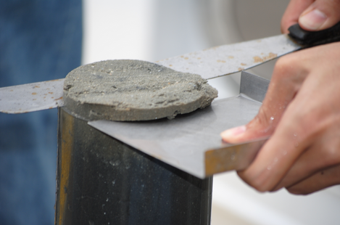
NIVAbasen – contaminants in sediment
PROJECTS PROJECT_ID
PROJECT_NAME PROJECT_DESCRIPTION
1-2 lines per station
PROJECTS_STATIONS STATION_ID
STATION_CODE STATION_NAME PROJECT_ID PROJECTS_STATION_ID
One line per sediment core (2-3 cores per station/year)
One line per slice of the core
SEDIMENT_SAMPLES STATION_ID
SAMPLE_ID
SAMPLE_POINT_ID
SAMPLE_DATE
WATER_DEPTH
SEDIMENT_SLICES SAMPLE_ID
SLICE_ID
DEPTH1
DEPTH2
STATIONS STATION_ID
GEOM_REF_ID
NIVA_GEOMETRY. SAMPLE_POINTS SAMPLE_POINT_ID
LONGITUDE
LATITUDE
One line per measurement
One line per method
SEDIMENT_CHEMISTRY_VALUES SLICE_ID
METHOD_ID
MATRIX
FRACTION_SIZE
VALUE
FLAG1
DETECTION_LIMIT QUANTIFICATION_LIMIT
UNCERTAINTY
METHOD_DEFINITIONS METHOD_ID
NAME (substance)
UNIT
LABORATORY
METHOD_REF
MATRIX

Slide 10
NIVAbasen – contaminants in water
PROJECTS PROJECT_ID
PROJECT_NAME PROJECT_DESCRIPTION
1-2 lines per station
PROJECTS_STATIONS STATION_ID
STATION_CODE STATION_NAME PROJECT_ID PROJECTS_STATION_ID
One line per water sample
WATER_SAMPLES STATION_ID
WATER_SAMPLE_ID
SAMPLE_DATE
DEPTH1
DEPTH2
PRE_TREATMENT_ID
SAMPLING_METHOD_ID
STATIONS STATION_ID
GEOM_REF_ID
NIVA_GEOMETRY. SAMPLE_POINTS SAMPLE_POINT_ID
LONGITUDE
LATITUDE
One line per measurement
One line per method
WATER_CHEMISTRY_VALUES WATER_SAMPLE_ID
METHOD_ID
VALUE
FLAG1
DETECTION_LIMIT QUANTIFICATION_LIMIT
UNCERTAINTY
METHOD_DEFINITIONS METHOD_ID
NAME (substance)
UNIT
LABORATORY
METHOD_REF
MATRIX
Note: treatment (filtering) is important

Slide 11
PROJECTS
PROJECTS
PROJECTS
PROJECTS_STATIONS
WATER_SAMPLES (or biological sample)
PROJECTS_STATIONS
WATER_SAMPLES
PROJECTS_STATIONS
WATER_SAMPLES
STATIONS
STATIONS
STATIONS
Cons:
- Cannot couple observations to projects (when there is >1 project per station)
Water samples can be linked to either Stations only (legacy data), or both Stations and Projects (all new data)
Pros:
Legacy data con just stay as they are
Cons:
- Not super elegant, complicates SQL
For new data, link samples to a single record in Project_Stations. For old data, link samples to all records with the given Station_id.
Pros:
- The ideal (?) solution for new data
Cons:
- For legacy data, some links will be expicitely wrong

Slide 12
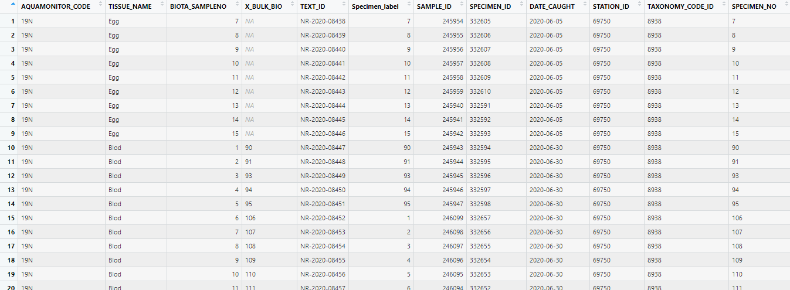
df_lookup_sample - from Labware and Nivadatabase - one line per sample
- Extracted from NIVADATABASEN data - Left joined using TISSUE and SAMPLE_NO
Left joined using SAMPLE_ID (via BIOTA_SAMPLES_SPECIMENS)
LABWARE_CHECK_SAMPLE
BIOTA_SAMPLES
BIOTA_SINGLE_SPECIMENS
- from TISSUE - matched to TISSUE in BIOTA_SAMPLES
- matched to SAMPLE_NO in BIOTA_SAMPLES
Depending on sample type, not necessarily a single number
- extracted from DESCRIPTION
Bottle label (used by NILU)
SPECIMEN_NO is set to X_BULK_BIO; if NA, BIOTA_SAMPLENO is used
If NAs here, something has been set wrong in Labware: Missing AQUAMON._CODE, TISSUE_NAME, BIOTA_SAMPLE_NO; text/letters i X_BULK_BIO; etc.
Note that Specimen_no and SPECIMEN_NO are not necessarily the same (the latter is set by Espen to secure that specimens are unique)

